Slide 1
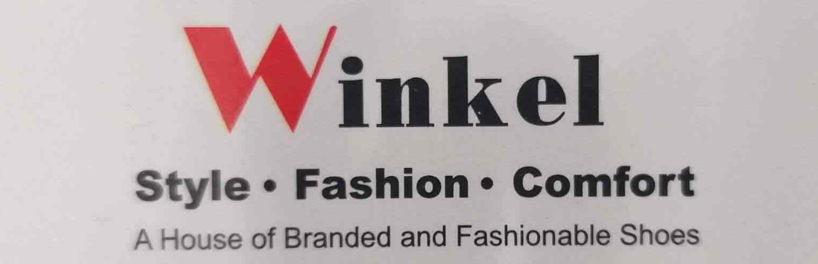
Business Data Management
Areebah Suhail – 21F1004521
B.Sc. Data Science & Programming
2nd Year

Slide 2
Monthly and Quarterly Analysis
Inferences
Monthly sales were highest in June & July for the year 2018.
In 2019 sales were highest in June but not consistent to 2018.
On an average sales were highest during the end of Q2 and beginning of Q3, these are the times of Muslim festivities, Ramadan and Eid, which might have affected the sales as the store is located in a Muslim neighbourhood.
There was a sudden stoop in March 2020 after having good sales in Jan which might have been the effect of Covid-19.
Recommendations
Advertising can be done all round Q1 with offers on high profit-high revenue or just high profit(refer slide 5) products especially.
The business can start by giving offers and discounts when footwear and clothing are bought together until the mid of Q2, to attract more customers by the time of festivities.
Keeping the store open for longer hours around Q2 and Q3 might help in sales.

Slide 3
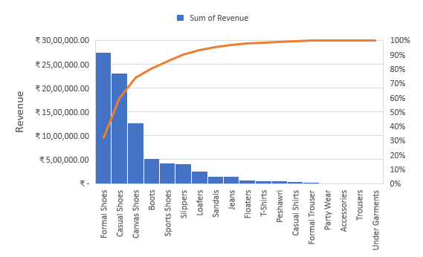
Revenue And Volume Analysis
Inferences
Revenue Pareto and Volume Pareto analysis showed almost same results.
75% of items sold are Formal, Casual And Canvas shoes that generate up to 80% of total revenue.
After these, Slippers, Sport Shoes and Boots have the most tendency to generate revenue and sales.
As the clothing and accessories category has just been introduced to the business(refer slide 4), jeans as a casual wear does show some little promise for future of the business
Recommendation
Clothing and accessories can be reduced to only clothing items, as there is almost no variety in accessories, this would give a bit more capital to invest in casual clothing inventory, and help increase revenue through it.

Slide 4
Monthly Volume Sales and Sales Mode Analysis
Inferences
Clothing and accessories category was introduced in Q1 2020 before the shop temporarily shut, so for 3 months the items did show some results.
Their were less items listed for e-commerce, but Formal shoes were found to be making more profit online than in store.
Recommendations
It is advisable to list all the products for e-commerce as it is cost effective, and helpful for business expansion.
Moving ahead keeping a ledger might help in understanding how often is re-ordering taking place and keeping inventories full during the efficient times of the year, with high revenue making items.

Slide 5
Profitability
Avg. Profit vs Avg. Revenue
Inferences
Every category have its high revenue high profit items(per piece), that are different from those that make most profit.
Recommendations
Recommended to attract customers using high profitable items using discounts and offers initially.
Business strategies can be used to create a need or appeal towards high profit-high revenue items, which could boost the company’s gross profit.
Combination discounts can be introduced, like if a person buy a pair of shoes and sandals they get to pay x% discount or on buying 2 pairs of jeans you get an x% off on T-shirt, etc.

